Slide 1

INTRODUCTION TO DATABASES
Week 8

Slide 2

Terminology
What is a Database?
Basic Database Terminology
Database Management Systems (DBMS)
Database Models
Entity Relationship Diagrams
Constructing an ER Diagram
Normalisation of Database Tables

Slide 3
WHAT IS A DATABASE?
A database is a collection of information organised and presented to serve a specific purpose.
One database that you would be familiar with is the phone book.
The phone book is organised so that a phone number can be quickly found given a surname and initial.
Another common example of a non-computerised database is the card catalogue system used in a library (though the use of cards is now disappearing).
Each book has its own card that includes information such as the name of the book, its catalogue number, the name of the author and a brief description of the book.
Each of these cards is known as a record. All the cards combined produce a database. This type of database can be visualized as shown in below iimage

Slide 4
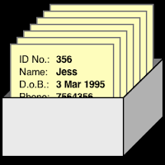
One record in database

Slide 5
major problems with this type of database are:
The difficulty in changing information on the card. If any information on the card needs to be changed, the card often has to be destroyed and another card typed.
The time required to find a book. As the number of books in a library increases it takes much longer to find the desired information, even when the cards are in a sorted order.
The time involved in adding new books to the system. This is especially true when there are multiple copies of the card catalogue.

Slide 6
Objective of database development
FIRST IMPORTANT OBJECTIVE
Is to allow the user to access the information required as quickly and efficiently as possible.

Slide 7
DATABASE TERMINOLOGY
Data
Data is the raw input that has very little meaning when viewed on its own. The smallest piece of data that can be stored in a database is a character, such as a letter of the alphabet, a punctuation character or a digit. Each of these characters requires one byte of disk storage space.
Fields
A field is a group of characters that has some meaning. The library database discussed previously could have, for example, four fields: the author, the catalogue number, the name of the book and the description of the book.
Field names
A field name is a name that the database designer assigns to a field. In this unit, field names will consist of one word in italics and will begin with an upper-case letter. Appropriate field names for the library database could be Author, Title, CatalogID and Description.
Records
A record is a group of fields that describe one entry in the database. For example, all the information contained on one card of the library database would form one record.
Files
A file is a collection of related records. The library database above consists of one file.

Slide 8
DATABASE MANAGEMENT SYSTEMS (DBMS)
A database management system:
Collection of programs that manages the structure of the database and controls who can access the data and how the data can be accessed.
The DBMS provides an interface between the user and the database itself. The main function of this interface is to enable the end user of the database to extract information from the data. This is known as a query.

Slide 9
DBMS
There are various DBMS currently on the market.
These include such software applications as:
dB2,
Oracle,
Access,
Ingress,
SQL Server,
Filemaker,
PostgreSQL,
MySQL and many others.

Slide 10
We use DBMS for:
define what type of data will be entered into the database
decide how this data will be organised in the database
add new records to the database
delete records from the database
view only sections of the database in which the user is interested or is authorised to access
extract information from the database that matches some condition(s)
modify the records in the database. This can be performed either globally (all data is changed) or based on certain conditions that the data must match
produce summary reports based on the information in the database
perform calculations on the data.

Slide 11
Second feature -important!
Most DBMS also incorporate the following features:
Implementation of a security system that provides security and confidentiality of data located in the database. This helps to prevent the unauthorised use and/or modification of the data.
Data validation, so the integrity of the data is maintained. Lack of database integrity occurs when invalid data is entered into the database.
Integrity can be maintained to a degree by validating the data as it is entered. Validation rules are limitations placed on the data.
Backup and data recovery. It is important to safeguard the data against accidental or deliberate loss caused either by a user or by a system failure.
To assist in the backing up of data, we can use a backup disk. If any data is lost, we can use the backup disk to re-install the missing data.

Slide 12
Database management systems consist:
Hardware. The physical machinery such as the computer, monitor, keyboard etc.
Software. The operating system, application program (Access, for example) and various third-party programs and utilities that work in conjunction with the operating system and/or the main application program.
People. System administrators, database administrators, programmers and the end users. System administrators’ responsibilities include maintaining the system software. Database administrators’ responsibilities include evaluating database designs, assigning access rights to individuals who use the database system and coordinating the development of applications based on the database. Programmers’ responsibilities include writing the code required to manipulate the data in the database and writing the programming code required to build the interface between the database itself and the end user. The end users are the people who actually use the DBMS. Generally this group of people is responsible for providing the input data and producing the required output.
Procedures. The instructions or rules regarding the use and modification of the system.
Data. The details that are stored in the database.

Slide 13
DATABASE MODELS
.The database models can be categorised as either conceptual or implementation models.
An implementation model is concerned with how the data is represented in the database. This type of model includes the:
hierarchical,
network and
relational database models.
The conceptual model is concerned with what is represented in the database rather than how it is represented. Conceptual models include the object oriented model and the entity relationship model.
As the relational model is the most common model in current use, this will be discussed in depth in this section.

Slide 14
The Relational Model
The relational model of database design uses tables of data to represent the entities about which we need to store information.
These different tables are then related together using keys or linking fields.
The purpose of the relational model is to provide for the following:
Elimination or minimization of data duplication
Provision of rapid access to specific data elements
Accommodation of possible expansion of the database in response to the needs of a growing organization.
Maintenance of data integrity so that the database contains only valid data.

Slide 15
Tables
A table is a collection of data divided into categories.
A category could be a customer name for example, or a customer address.
These categories are known as fields or columns in a table.
In the following example we can see that the Customers table is divided into different fields.
By breaking down the information into fields we can do things, such as sort, search and easily manipulate the table information in any way we choose.

Slide 16
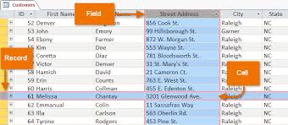
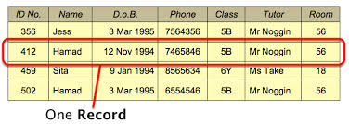

Slide 17
IMPORTANT ABOUT TABLES
A table can hold hundreds, thousands, even millions of records.
We can also manipulate the records in many different ways, for instance grouping records in reports.
To meet all the requirements of the relational model it is important that we design our databases in such a way that each table only contains information about a single entity.
Deciding which table a piece of information belongs in can be a tricky process.
Even if you are only ever going to extract data from databases designed by others, it is still important to understand the design process so you have some idea of the reasons for the different tables in your database and how they relate to each other.

Slide 18
Designing a Database
There are many database design methodologies that can be used when designing a database.
They are used by developers to ensure that every aspect of the database design process is taken care of.
Even though we are not going to look at specific methodologies, you will find the following guidelines useful in designing your database application.

Slide 19
Our Method for the class
Step 1:
First of all define what the purpose of the database is. Have a clear idea of what the database is to be used for.
Step 2:
Next you will need to decide what fields are needed. These will be determined by the purpose of your database. Try to break up the information so that it will be useful at a later stage. For example, if you have the customer name details broken up into their title, first name and last name, you will be able to do things such as sort customers in alphabetical order by their last name. This can then be used to find a customer's record quickly and easily.

Slide 20
Step 3:
Decide what tables will be needed in your database. Based on the fields that you need to store in your database, you will need to decide what tables will be required. A few small tables are easier to manage than one large table.
For example, if you want to keep track of books for particular customers, you will need an Books table for order details and a Customer table for customer information.

Slide 21
Step 4:
Determine what relationships are to be established between tables.
Look at your tables and decide how the information is going to be related. You may have to introduce additional unique fields in your table to achieve this.

Slide 22

Step 1 Explained
The first part in designing your database is to define its purpose.
From here you can then start designing the database around specific tasks or functions. For example, if we had a PWA Employees database, some of its tasks might be to monitor staffing levels, produce salary information, keep a list of employee holiday entitlements, etc.

Slide 23
Defining its purpose is not as easy as it at first seems.
You may have to put in some hard work on this one. Gather as much information as you possibly can.
If you are designing a database around an existing manual or computerised system, define all the steps that are currently involved.
If you are starting from scratch, talk to all the people that will be using the database and find out what they need from the system and what they see as the purpose of the database.
Start sketching the reports you would like to see from the system. All this will help you determine what you will need to define in your new database system.

Slide 24
HOW TO ORGANIZE THE INFORMATION IN YOUR DATABASE?
STEP 2: Defining the Data Items for a Database
We need to take a look at what data items will need to be stored in order to accomplish the database tasks you have decided upon.
The data items are the individual pieces of data that are going to be stored in the database tables. An example of a data item is someone's last name or a weekly salary amount.

Slide 25
Step 3 EXPLAINED
Deciding on the Tables Needed in Your Database
A table is used to store information in your database.
We need to decide what tables are going to be used and how the data items and information will be arranged between the tables. When deciding on how your database will be structured you will need to strive for efficiency in your database.
In single table databases, every time information needs to be added, it is simply a case of entering a new record.

Slide 26

A single-table database structure is not efficient when we need to keep track of information that is changing for a lot of different transactions.
Take for example the case where you want to keep track of students (lecturers) details and invoicing in a single table. We would encounter what is known as data redundancy. That is where we are duplicating information unnecessarily.

Slide 27
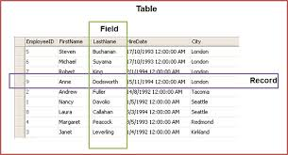
Another example
Comments please?

Slide 28
a waste of time
As you can see from the example, as new records are being added to this table we are duplicating the customer details and the furniture details.
Due to the duplicated information, it takes longer to enter the information for each invoice, the database is bigger than necessary, and that in turn would mean that your application would run slower.
If the customer changed address before we billed them and they had quite a few entries in the table, we would have to change all the invoice details for that customer in our database, which is definitely a waste of time.

Slide 29
Normalisation ( DO NOT SKIP THIS EITHER)
An alternative to creating one single table for an invoice table would be to create several tables, each containing the information necessary to track invoices.
Take a look at the example below of how we might structure the same database.
The process we use to organise information into groups of tables is known as normalisation.

Slide 30
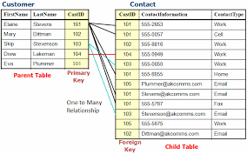

Slide 31
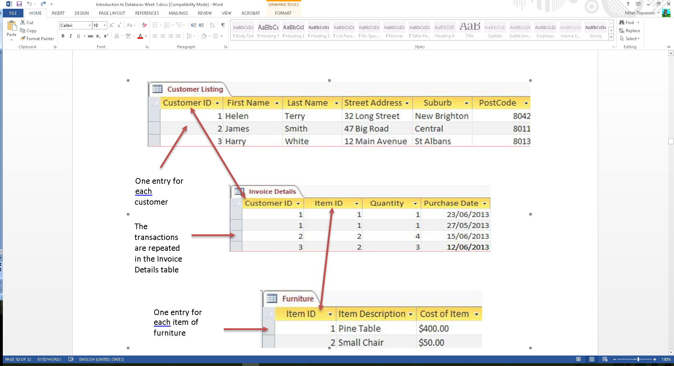

Slide 32
Types of Tables
Once you have decided upon the individual tables needed in your database, you will need to relate the information in the various tables. There are a number of things we need to do in order to create this link. First of all, we will need to look at the types of tables we have in our database.
In a related database there are two main types of tables, called the primary tables and the linking tables.
A primary table usually consists of the information that is going to remain relatively constant. In the previous example where we were keeping track of orders placed, the primary tables would be the Customer Listing table and the Furniture table.
The information will not be changing that often and will almost always be unique.

Slide 33
Creating Table Links
In order to create a link between the primary and linking tables in our database we need to ensure that we have a common field between the two. This field will be a unique field in the primary table and a repeated field in the linking table. This would allow us to create a one to many relationship between the primary and linking tables, as in one customer with many orders.
In most cases we would usually create an additional field in our table to ensure that we had a unique field to link information.
Again in our example, we created a unique Customer ID field in case we had some customers with the same name, and a corresponding field in the Invoice Details table which also contains the Customer ID.
The same Customer ID may appear in the Invoice Details table many times, that is for every order placed by that customer.

Slide 34
Primary and Foreign Keys
When we create a unique field to identify each record in a database, the field is known as a primary key. The primary key is the field or combination of fields that uniquely identify each record. When more than one field is needed to create a primary key, it is known as a composite primary key.
To be able to relate the information from one table to another table, we need to include the primary key of the primary table in the table to which it is being linked (linking table). This is known as a foreign key. A foreign key is defined as the field in the linking table that refers to the primary key of the primary table.
For example, if your database contained information on products in one table, and another table contained information on your suppliers, it would be very useful to include a field in your products table that gave a direct link to the primary key in your suppliers table.
This way, for each product the computer could trace the link back to the suppliers table, hence enabling the computer to tell you who supplied that product. This field in your products table would be an example of a foreign key.

Slide 35
Conceptual Model
When designing databases the most common tool for modelling relational databases is the entity relationship model.
An entity can be classified as a person, place, event or thing for which data is to be collected and stored.

Slide 36
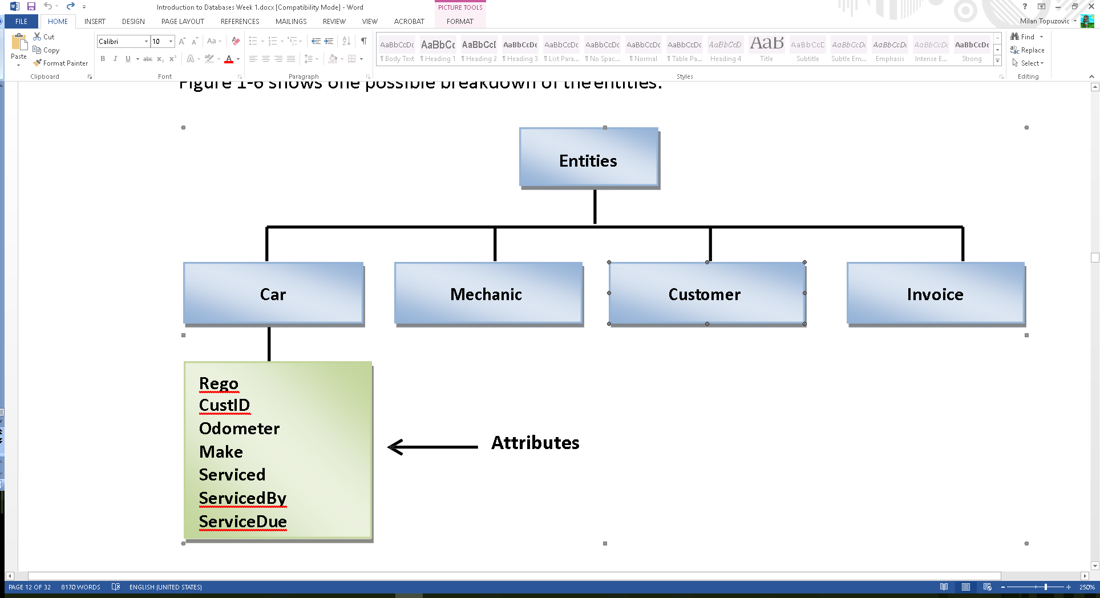
1 Step entity
The first step is deciding on which entities are needed, and which attributes each entity needs.

Slide 37
Nouns
Nouns should be used when naming the entities and each entity has properties called attributes that describe the entity. You can think of the entities as representing the tables in a relational database and the attributes as representing the fields.
In the Car entity above, we can see the listed attributes Rego, Odometer etc. There may be many more attributes for the cars than those shown in our example above.
The number of attributes required is determined by the information you wish to obtain from the database. Adding extra attributes that are not required only increases data entry time, and adds to the complexity of the database design, as well as occupying extra storage space.
What attributes may each of the other entities in our example require? For the Mechanic entity, the attributes could include the name of the mechanic, his/her address, phone number, commencement date and qualifications.

